Slide 1
Web Fundamentals
By: Tobi Ogungbe

Slide 2
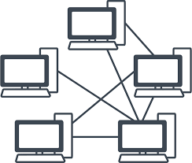
What is Network?
Network is the interconnectivity of endpoint devices, which can be computers, devices, or other entities, that share data and resources

Slide 3
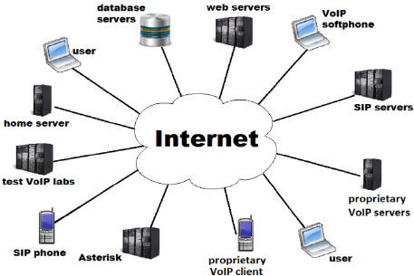
What is Internet?
The internet is a global network connecting billions of devices, facilitating communication and access to information.

Slide 4
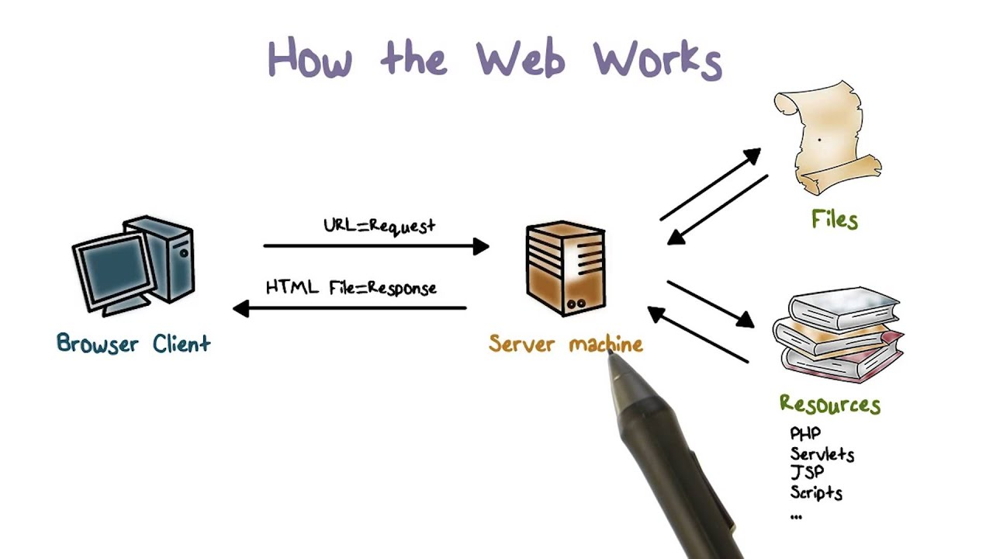
Functionality of Web
A web browser (client – Laptops, Tabs, Phones, TVs) requests resources like HTML files, images, and videos from a web server. Using HTTP, servers transmit these resources over the internet to the client.

Slide 5

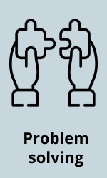





Requirements to be a Web Developer
Soft Skills

Slide 6
Requirements Contd. - Hard Skills
- HTML/CSS Coding
- Responsive Design
- Testing and Debugging Skills
- Front-end Scripting
- Back-end Scripting
- Search engine optimization
- Frameworks ie: Laravel
- API/Plug Integration

Slide 7


Why Learn Web Development?
Ability to turn real ideas into working products
Ability to freely create web solutions for clients without being at the mercy of a developer.
Additional bargain power during negotiation.
Digital nomad opportunities.
Numerous remote-friendly web development job opportunities.
Ability to work with multiple client.

Slide 8



Why Learn Web Development?
High demand across various industries.
Prospect of becoming a Full Stack Developer
Opportunities range from doing freelance work to full-time positions in tech companies.
Ability to combine creative skills (design (UI/UX)) with technical (programming) skills.
Ability to build visually appealing and functional websites.

Slide 9
THANK YOU!

